Slide 1


Record to Report: Corporate Accounting 1 – COA and GL
15-Feb-2023

Slide 2
Agenda
1.0 Introduction Assessment Objective
2.0 Capability Deep Dive
3.0 Key Design Decisions
4.0 Integrations & Conversion
5.0 Review Actions – (question responses)

Slide 3
Session Objective
General Ledger
Duration | 2 hours
Objective | Provide an overview of functionalities, leading practice recommendations, and considerations related to General Ledger. Gather inputs to finalize solution, integration and conversion scope for the implementation of related capabilities
Key Activities | Process Overview Process deep-dive Discuss confirmation questions Review key capabilities and leading practices Discuss data elements and key design decisions
What this is not | Design future state processes, finalize design decisions Gather Requirements Perform Fit-Gap analysis and solutions for business requirements

Slide 4
General Ledger: Record To Report (RTR)
Track wise Process flows for Client
Reporting
Level 1
Security and Controls (S&C)
Organizational Change Management (OCM)
Procure to Pay (PTP)
Acquire to Retire (ATR)
Record to Report (RTR)
Level 2
Manage Procurement
Manage Payables
Manage Fixed Assets
Manage Accounting and Control Data
Cash Management
Intercompany
Manage Contracts
Vendor setup
Perform Asset Additions
Maintain Enterprise Structure
Bank Statement Reconciliation
Generate Financial IC Transactions
Create Requisitions
Process Invoices
Adjust Assets
Maintain Chart of Accounts
Reconcile IC Accounts
Manage Purchase Orders
Employee Expense Reports
Transfer Assets
Maintain Currency & Rates
Process Receipts
Retire Assets
Process Interfaced Journal Entries
Manage Payments
Level 3
Process Manual Journal Entries
Vendor Onboarding
Period End Close
Reinstate Assets
Approve and Post JEs
Sourcing
Bank Setup
Depreciatie Assets Period End Close
Process Reversing JEs
Maintenance Repair Operations (MRO)
Maintain Asset Books
Process Recurring JEs
Short Term Maintenance
Perform Allocations
Perform Closing
(Period End)
Legend :
In Scope- L3 ATR Processes
L3 Processes- Other Tracks
Out of Scope
Financial Reporting

Slide 5
Record To Report (RTR)
MAINTAIN ENTERPRISE STRUCTURE

Slide 6
Overview: Oracle Cloud Enterprise Structure
What does the Enterprise Structure represent in the Oracle ERP
Enterprise
Inventory Organization
Cost Centers and Departments
Business Unit
Ledger
Legal Entity
The Oracle Applications financial enterprise structure defines organizations and the relationships between them in arbitrarily complex enterprises
This organization model serves as the cornerstone for the Oracle Applications products / modules
It dictates how transactions flow through different organizations and how these organizations interact with each other
It is the foundation of all Oracle Application products and is a configuration that enables data belonging to multiple business units in an enterprise to use a single installation of Oracle Applications
Keeps transaction data separate and secure within the logical confines of the defined structure

Slide 7

Enterprise Structure – Definition
Enterprise
The highest-level classification under which the structure is deployed
This captures the name of the deploying Organization and the location of its headquarters
This is the first setup that is performed before carrying out any other enterprise structure related setups
Legal Entity
Represents the Legal company. These are entities that can own assets, record sales, pay taxes incur purchases.
Legal entities registered under a specific jurisdiction may be allowed to operate in other jurisdictions. Different reporting requirements may exist in different jurisdictions.
Defines tax and fiscal reporting levels - a legal entity is assigned to a single ledger; a ledger can have multiple legal entities
One or more balancing Segment values are assigned to the legal entity indicating the relationship of the values to legal entities.
Used in Intercompany processing- Intercompany balancing rules can be specified at legal entity level
Ledger
A ledger is a single place which stores the impact of all financial transactions carried out by the company. A ledger is defined by 4C’s – Chart of Accounts, Functional Currency, Accounting convention, Calendar.
Legal Entities and Business Units are associated to a specific ledger.

Slide 8
Business Units
Enterprise Structure – Definition [Cont.]
Business Unit represents a unit in the management hierarchy that performs one or several of the business functions.
Sub ledgers are defined at this level (Payables, Procurement, Receivables etc.).
Business unit is associated to a Primary Ledger in the enterprise structure. It does data segregation and Security functions:
Partition transactions – Business transactions generated in a particular business unit are stored separately from transactions processed in other business units
Secure transactions – Assign data roles associated with business units to users to secure visibility of business transactions
Business Unit relationship with Legal Entity and Ledger:
A business unit processes business transactions on behalf of one or more legal entities
They are assigned to a primary ledger and a default legal entity.
Sub ledger
Invoicing
Receivables and Collections
Requisitioning
Business Unit
Business Functions
Procurement
Bank Account Mgmt. & Reconciliation
Expenses
Business Unit Considerations
Centralized Vs Decentralized Models
Ledger

Slide 9
Business Units – Centralized vs. Decentralized model
Decentralized
Centralized
BU1 | BU2 | BU3
Requisitioning Procurement Payables | Requisitioning Procurement Payables | Requisitioning Procurement Payables
BU1 | BU2
Requisitioning Payables | Requisitioning Payables
BU3 Procurement Servicing Unit
BU1
Requisitioning Payables Procurement
Key Design Decision
Do you have Centralized or Decentralized business functions?
In a Decentralized model, each business unit performs all the business functions by itself. s
In a hybrid model, few but not all functions are performed on behalf of other units. In the above scenario, BU3 performs Procurement function on behalf of BUs 1 and 2
Options | Pros | Cons
Decentralized Model | Each BU has its own ability to manage its own functions. E.g. Procurement can be done by each unit for its own requirements More autonomy for departments. Increased attention to users and responsive to specific user needs | Due to multiple practices in various business units, there is no accountability and control over the processes. Cost synergies are not available Difficult to standardize processes.
Centralized Model | Generates economies of scale – Leads to significant cost savings and better negotiating abilities Best practices can be easily adopted Increased collaboration with departments | Less tailored to business users. Less responsive to customer needs. Slower decision making

Slide 10
Enterprise Structure – Definition [Cont.]
Department / Cost Center
A department is an organization with one or more operational objectives.
Departments are responsible for cost control, manage employees within their departments.
In Oracle cost centers are assigned to each employee which is in turn used for expense, invoice and Purchasing approval processes.
Departments are represented in Chart of Accounts by way of one or more cost center segment values.

Slide 11
Manage Enterprise Structure: Primary Ledger
Chart Of Accounts
Currency
Ledger
Accounting Calendar
Accounting Convention Method
Each accounting setup requires a primary ledger and optionally, can include one or more secondary ledgers and reporting ledger.
A ledger is a financial reporting entity that partitions General Ledger information and uses 4 C’s.
Chart of Accounts
Accounting Calendar
Functional Currency
Accounting Convention
A ledger secures General Ledger transaction information such as journal entries and account balances.
The number of ledgers and sub ledgers is unlimited and determined by your business structure and reporting requirements.
Discovery Questions
What are the different accounting calendars/type (fiscal/4-4-5) used across your legal entities?
Do you have adjustment periods?

Slide 12
Ledger Sets
Enables you to group multiple ledgers that share the same chart of accounts and calendar to increase efficiency of period close, security administration and reporting
Allows you to treat multiple ledgers as one:
Open and Close Periods: Open and close periods for multiple ledgers within a ledger set from a single operation
Translation and Revaluation: Translate balances and run revaluation across multiple ledgers in a ledger set.
Reporting: Submit standard reports and Financial Reporting Studio (FRS) reports across multiple ledgers in a ledger set. The added benefit of using ledger sets in FRS reports is to aggregate data and create summarized balances across multiple ledgers in a ledger set.
Inquiry: Perform online inquiry on account balances or journals across multiple ledgers in a ledger set from a single view; drill down to the journal details and subledger transaction for each ledger.

Slide 13
Manage Enterprise Structure: Secondary Ledgers
A secondary ledger is an optional ledger linked to a primary ledger for the purpose of tracking alternative accounting. A secondary ledger can differ from its primary ledger by using a different accounting method, chart of accounts, accounting calendar, currency, or processing options.
Primary Ledger
Transfer journal balances from Primary to the Secondary Ledger.
Conversion Levels:
SubLedgers
Balances
Adjustments Only
Journals
Secondary Ledger
Accounting
US GAAP
Global COA
Global Calendar
Functional Currency
Local GAAP
Local COA
Local Calendar
Local Currency
Subledger Accounting Rules
Subledger Transactions
AP
AR
FA
Other
Subledgers
Transactions

Slide 14

Manage Enterprise Structure: Reporting Ledgers/Currencies
Reporting Ledgers/Currencies are not same as Secondary Ledger. If you only need multiple currencies to support your reporting requirement, use reporting ledgers/ currencies. If you need to account for your data using different 4’C in addition to currency, use a secondary ledger.
Reporting Ledger
US GAAP
Global COA
Global Calendar
Target Currency
Primary Ledger
Secondary Ledger
Mapping Rules
US GAAP
Global COA
Global Calendar
Functional Currency
Local GAAP
Local COA
Local Calendar
Local Currency
Local Statutory Reporting
Accounting
Manual/Excel Upload JEs,
External Feeds
(GL Transactions)
Manual Adjustment JEs
SLA
Mapping Rules
SLA
Subledger
Accounting
Subledger Transactions
(AP, AR, FA) GAAP, Global COA

Slide 15
Manage Enterprise Structures: Leading Practices
Leading Practice | Benefits / Rationale
Avoid ledgers that span across countries | Local regulations often vary between countries
Avoid more than one primary ledger per country
Primary ledger follows corporate accounting convention | Allows for multinational shared service centers, single user working with multiple countries
Avoid non-local functional currency in the ledger | Allows for easier subledger based regulatory reporting
Limit the number of balancing segments to one | Avoids numerous intercompany transactions
One Secondary Ledger for each International Primary Ledger where Local GAAP reporting and alternate financial representation is required | Maintains compliance with local/statutory needs and facilitates local adjustments
One Reporting Currency Ledger (in Local) for each international Primary Ledger (as applicable) | Ability to utilize Ledger sets to consolidate Reporting Currency Ledgers (in Local Currency) No need to perform translations because users can view the Local ledger any time
Use separate ledgers for consolidated vs non-consolidated entities | Simplified Management reporting in a segregated environment
Create separate Business Units to separate data and process subledger transactions | Ability to segregate and partition transactional data specific to operations Enables more intercompany automation

Slide 16
Review Action Items
Questions on Enterprise Structure
No | Action Item | Comment | Owner | Due Date
1 | Number of legal entities and hierarchy (list or diagram)
2 | what currencies you primarily operate in and report in besides Functional Currency?
3 | Legal entity functional currencies and required transaction currencies
4 | Legal entity subledger processing by entity
5 | Relationship between Legal Entities, Primary/Secondary Ledgers, Reporting Ledgers and Business Units (list or diagram)?
6 | What countries have government mandated chart of account structures?

Slide 17
Record To Report (RTR)
MAINTAIN CHART OF ACCOUNTS

Slide 18
Maintain Chart Of Accounts
The Chart of Accounts (COA) is the account structure the organization uses to record transactions and maintain financial account balances. Management must define the dimensions by which financial data will be analyzed and reported and ensure that those dimensions are reflected in the segments of the COA structure.
Oracle COA Structure
SAP COA Structure
Seq. | Segments | Size | Datatype Numeric vs Alpha-Num?
1 | Company | 5 | Alpha-Num
2 | Account | 7 | ?
3 | Sub-Account | ? | ?
4 | Site | 3 | ?
5 | Department | 3 | ?
6 | Studio | 3 | ?
7 | Platform | 3 | ?
8 | Project | ? | ?
9 | Future 1 | ? | ?
10 | Future 2 | ? | ?
11 | Intercompany | 5 | ?
Seq. | Segments | Size | Datatype Numeric vs Alpha-Num?
1 | Entity
2 | Account
3 | Site
4 | Department
5 | Studio
6 | Platform
7 | Project
Discovery Questions
What is your current process for maintaining the chart of accounts?
How do you manage the approval process for changes to the chart of accounts?
In the future, who should own this process? Should ownership be shared?
How do you maintain the chart of accounts mapping? What applications leverage this mapping?
What challenges do you have with this process today?
Does the current Chart of Accounts structure capture all the key elements needed for reporting?
Are the segments normalized and used consistently globally?
Q: Is Sub-Account Seg is dependent on Account Segment? | Q: Need detail discussion on Dept – list has similar values i.e.: HR vs. W_HR?
Q: Are there any other dependent Seg? | Q: Need the parent-child hierarchies for each segment
Q: Need of full list of values and hierarchy for each segment.

Slide 19
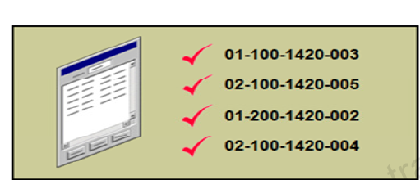
Cross Validation Rules (CVR)
A cross-validation rule defines validation across segments and enforces whether a value of a particular segment can be combined with specific values of other segments to form a new combination.
Rule Feature | Definition/Purpose
Name | Uniquely identifies cross-validation rules in a deployment.
Description | Helps administrators identify the purpose of the rule.
Error message | Explains why the attempted combination violates the rule.
Start Date, End Date | Indicates the period of time when the rule is in effect.
Enabled | Determines whether the rule is enforced.
Condition filter | Determines the conditions under which an enabled cross-validation rule should be evaluated.
Validation filter | Determines the validation that the rule enforces when that condition is met.
Cross-validation prevents creation of invalid combinations by administrators using maintenance pages and end users using dynamic insertion in foreign key pages.
Points to Consider:
Cross-validation rules have no effect on combinations that already exist. The flexfield treats any existing invalid combinations that pre-date the rule as valid.
Examples:
P&L Accounts (40000-49999) should have a default Depart (00000).
P&L Accounts (50000 - 59999) should have a valid Dept (Non-Zero)
Intercompany segment value should not be default value (0000) if natural account segment value is 621100 (IC Rev)

Slide 20
Cross Validation Rules (CVR): Leading Practice
Leading Practice
Define the rules high level and keep the rules simple. If they are too detailed, your chart of accounts are less optimal for transactions
High use areas for Journals are of greater focus of CVR
During design we should consider only two segments at a time
Logically Group the CVR Rules logically
Every CVR rule must have a “universal include” row, and then followed by the “excludes”
Define the error messaging clear and concise for the users and interfaces to understand
Remember to execute the cross validations rule violation report after keying in your cross validation rules
Advisable to have a half yearly review of rules and adjust as needed

Slide 21
Record To Report (RTR)
MAINTAIN CURRENCY & RATES

Slide 22
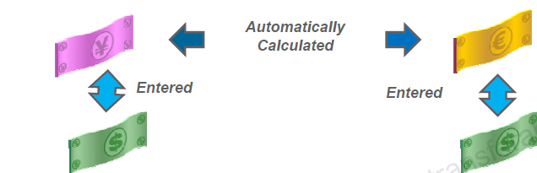
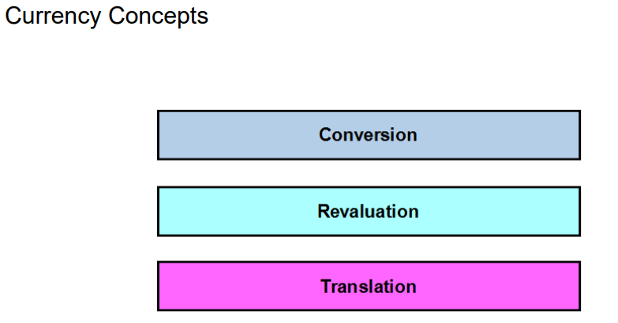
Multi-Currency and Rates
Record Transactions, Journal Entries & Reports in any Currency
Enters Daily Rates online or automatically
Perform Currency conversion online and in Real Time
Compliance with Generally Accepted Accounting Principals
Enterprise can define different conversion rate types as per their business needs for purpose of recording transactions or translation of balances.
The following three currency processes are performed in General Ledger:
Conversion: Refers to cross-currency transactions that are converted during the accounting transformation to the currency of the ledger in which the transaction takes place.
Revaluation: Adjusts asset or liability accounts that may be understated or overstated at the end of a period due to a fluctuation in the conversion rate between the time the transaction was entered and the end of the period.
Translation: Restates an entire ledger or a set of balances for a company from the ledger currency to a reporting currency.
Notes:
Nick

Slide 23
Currency Gain/Loss - Overview
Foreign currency gain/loss (FX) transactions in Ledger can be generated from multiple sources:
Realized FX: Realized foreign exchange gain/loss is generated within the Ledger native Subledger. For e.g., when a foreign currency supplier invoice is paid, any resultant exchange rate gain/loss is automatically booked in the AP subledger
Unrealized FX: Unrealized foreign exchange gain/loss is generated as a calculation of total foreign currency balance and the associated functional currency balance. This calculation is performed directly in general ledger and the resultant gain/loss is typically booked as a journal entry that is reversed the subsequent month.
Realized Gain/Loss – From subledgers
Unrealized Gain/Loss – From Revaluation in General Ledger
Payables*
Other
Subledgers
Revaluation
General Ledger
Subledgers maintain detailed information to calculate, and book realized gain/loss.
General ledger maintains summary balances to calculate Unrealized gain/loss
* Used as an example for discussion. There are other subledgers that generate realized gain/loss

Slide 24
Overview of Revaluation
Prerequisites:
Define an unrealized gain/loss account
Define a period end rate type and create a period end rate for each currency if required
Running Revaluation:
Revaluation is typically run at the end of each accounting period as part of the close process to revalue balance sheet accounts that are denominated in a foreign currency in accordance with SFAS 52 (US)
The journal is then reversed at the beginning of the next period
Currencies:
Revaluation can be run for a single foreign currency or for all currencies
When you run revaluation, GL creates a revaluation batch containing a separate journal entry for each revalued foreign currency
Revalue Foreign Currency Balances
Post to Unrealized Gain/Loss Account
Reverse Revaluation Journals
Is the foreign Currency Receivable Still Unpaid?
Yes
No
Collect Foreign Currency Receivable
Post to Realized Gain/Loss Account

Slide 25
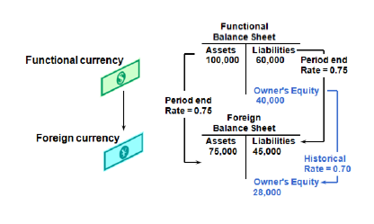
Overview of Translation
Running Translation:
Restates your ledger currency account balances into a reporting currency. For example, if we want to maintain a ledger in USD (functional currency) as well as Euro (reporting currency), then we can use reporting currency Leger to capture every transaction in Euro.
Translates actual balances from ledger currency to foreign currencies for online inquires, and consolidations
Supports multiple balancing segments for the Retained Earnings and Cumulative Translation Adjustment accounts
Rates by Account Type:
B/S Accounts -> Period End Rates
P&L Accounts -> Period Average Rates (Optional)
Equity -> Historical Rates
Conversion Rate Types Configuration
Rate types are used to translate from entered foreign currency to ledger functional accounted currency
Cloud Rate Type | Description
Average | Average Rate
Spot | Spot Exchange Rate
Corporate | Corporate Exchange Rate
User | User Specified Rate
Notes:
Nick

Slide 26
Record To Report (RTR)
PROCESS INTERFACED JOURNAL ENTRIES (JEs)

Slide 27
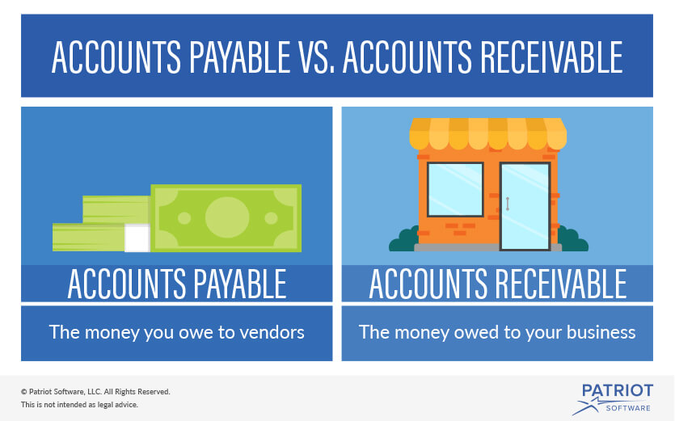
Process Interface JEs
Importing Journals
Journals could be imported from Subledger applications including both Oracle and non-Oracle.
This method efficiently and correctly populates the bulk of the data in the ledger.
Oracle Subledgers
Non-Oracle 3rd Party Applications
Customer
Bank Recon.,
Receipt Recon.
Cloud Cash Mgmt.
Cloud Purchasing
Cloud Payables
Cloud Fixed Assets
Cloud Receivables
Matching
Supplier
Import
Invoices, Payments
Revenue Accounting Events
Misc Cost Accounting
Collections
Receipt Accruals
Depreciation, Adj.
Invoices, Cash Receipts
Discovery Questions
What are the different sources of journals?
What are the different third-party journals that feed journals into General Ledger?
How do you name journals?
Summarization level while importing journals from subledgers
Subledger Accounting Engine
Legend
Transfer and Post Accounting
Cloud Module
General Ledger
Accounting Engine
Ledger
Essbase Cube
3rd Party
Oracle EPM
BOI / Local Banks
Payroll Systems
Employee Expenses?
Any Other?

Slide 28
Record To Report (RTR)
PROCESS JOURNAL ENTRIES (JEs) – MANUAL

Slide 29

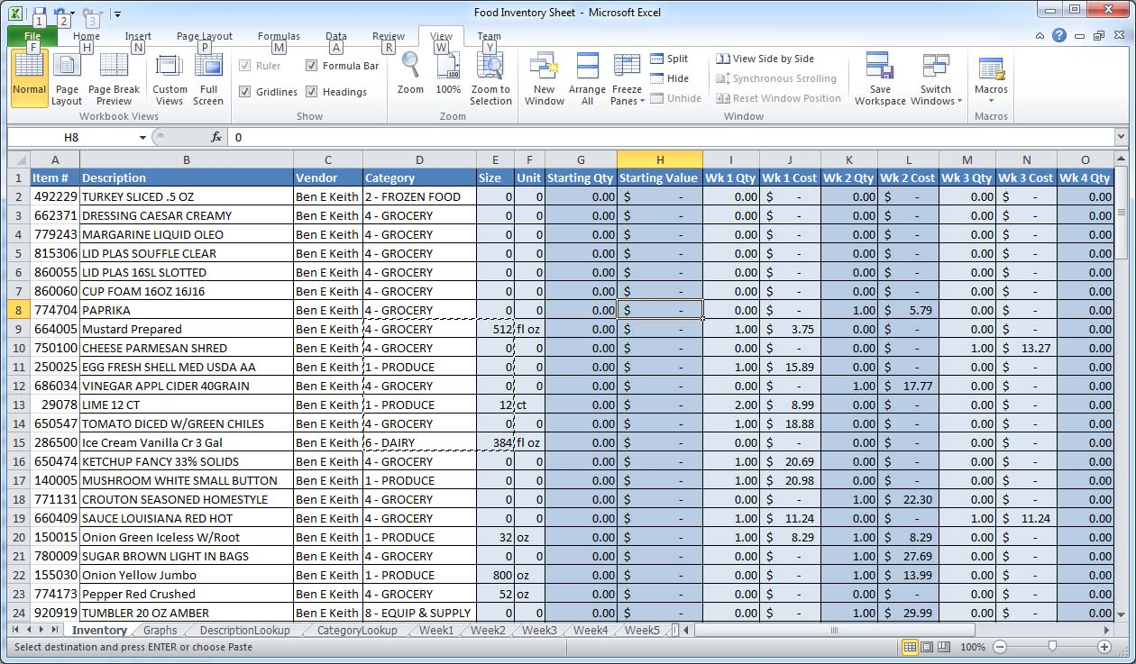
Process Journal Entry - Manual
Entering Journals Manually
Used for journal entries that occur once or infrequently such as journals to Correct errors ,Reclassify account balances, etc.
This method requires the most time and is open to errors from human intervention
Ledger Currency Journals
Foreign Currency Journals
Reversing Journals
Intercompany
Copying Journals
Create manual journal entries after entering journal details e.g. accounting period, ledger, journal category, etc.
Submit manually entered journals for approval
If the journal is rejected then edit, correct or delete incorrect manual journal entry
Post the journal entry
Manual
Discovery Questions
What are the means of entering journals in the current system?
Journal sequencing requirements?
Entering Journals in ADFDi
Used to manage large volume data uploads into Cloud
Working with Oracle Templates adds functionality such as the use of macros, formulas, and links to existing documents.
Download the ADFDI Template
If the journal is rejected then edit, correct or delete incorrect lines in the Template
Upload & Post the journal entry
Enter Journal Details in the Template
Upload the Journal
Standard Journals
Recurring Journals
ADFDi

Slide 30
Process Journal Entry - Demo

Slide 31
Record To Report (RTR)
Approve and Post JEs

Slide 32




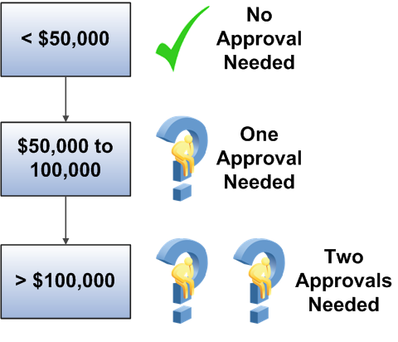
Process Journals and Approvals
1
Journal Approval : Key Concepts
Approval is enabled at the ledger and source level. Both the ledger and journal source must be enabled for the approval process.
Approval is for the entire journal batch and not for specific journals within the batch
If a journal requires approval, submitting it for posting automatically sends it for approval before posting
Oracle provide the following approver lists for generating the approval hierarchy:
Human Resources (HR) Supervisory
Job Level
Position
Approval Group
Journal Approval: Points to Consider
Journal Sources for which journal approval is needed needs to be determined. Example: Subledger Journals can be exempt from approval whereas Manual Journals would need approval
Journal approval behavior can be determined by where we are in the period close process. Example: Month-end or quarter-end closing entries can be:
Larger amounts than entries that are earlier in the month and can need more levels of approval.
Entered by employees with more authority so need less levels of approval.
.
Enable Journal Approval
2
3
Specify Journal Sources
Create Journal Approval
Rules
Discovery Questions
Current approval process and approval rules?
How many approvers do you have in system?

Slide 33
Record To Report (RTR)
Process Recurring JEs

Slide 34
Process Recurring Entries
Recurring Journals: Key Concepts
Recurring entries are journals that needs to be repeated and processed periodically. Examples: Insurance premium to be paid monthly
We can use the following types of recurring journal entries to reduce data entry time and increase accuracy of journal entries
Skeleton
Standard Recurring Journal Entries
Formula Recurring Journal Entries
Discovery Questions
Do you use recurring journals? Can you provide high level details?
Skeleton journal entries contain the same accounts each period but have different amounts.
Standard recurring journal entries contain the same accounts and amounts each period
Here, the journal amount vary from period to period and are based on existing account balances or other criteria.
Recommended to skeleton recurring journal entries by updating existing journal Templates and upload or copy existing journals.
Recommended to create standard recurring journal entries by updating existing journal Templates and upload or copy existing journals.
Recommended to create these journals using the formula component and allocation wizard in the Calculation Manager

Slide 35
Record To Report (RTR)
Process Allocations

Slide 36

Process Allocations
Allocations : Key Concepts
Allocation manager (Hyperion Calculation Manager) is used to create allocation and other formula-based journal templates for generating periodic journal entries automatically.
The Calculation Manager is a powerful tool that leverages Oracle Essbase and provides flexibility, automation, intelligence, and control in distributing costs and revenues across the enterprise
Allocations are defined and generated on top of the multidimensional balances in the Essbase cubes.
Oracle Essbase is seamlessly embedded within Cloud General Ledger and provides the multi-dimensional cubes.
Can create processing schedules for recurring journal entries that have been defined in the Calculation Manager. Scheduling automates the monthly generation of the entries and speeds up the close process.
Can define multiple schedules for each calendar in General Ledger. These schedules can increment by accounting period, based on any calendar defined.
Allocation
Reversal Criteria Sets
Revaluation
Automatic
Discovery Questions
Do you use Allocations? Can you provide high level details?

Slide 37
Record To Report (RTR)
Process Reversing JEs

Slide 38
Process Reversals
Process Reversals: Key Concepts
Examples of journals which need to be reversed: accruals, estimates, errors, or temporary adjustments and reclassifications.
There are two ways in which a journal entry can be reversed:- ‘Switch DR/CR’ or ‘Change Sign’
Journals that have already been reversed once cannot be reversed again.
Only posted journals can be reversed
Reversing journals saves time and prevents data entry errors
Methods to reverse journal entries:
Manually select for reversal and generate in the current period
Manually select for reversal and generate in a later period
Automatically reverse journals using ‘Journal Reversal Criteria Sets’
Auto Reverse Process :
The ability to submit journal reversals automatically enables us to automate and streamline the journal reversal process.
If a large number of journal reversals are generated for month end closing, this functionality helps to save time and reduce entry errors.
Journals which are to be auto-reversed should be created with specific Journal categories attached to ‘Journal Reversal Criteria Sets’
Journal reversal criteria sets need to be assigned to ledgers
The ‘Auto Reverse’ process can be submitted ad-hoc , scheduled to run automatically or set to be triggered upon period opening
The Auto Post process can be set to automatically post the journals generated by the Auto Reverse process.
Journals posted by the Auto Reverse process always bypass approval
Discovery Questions
How do you reverse a journal in the current system?
What are the different types of accrual entries? How are they processed?

Slide 39
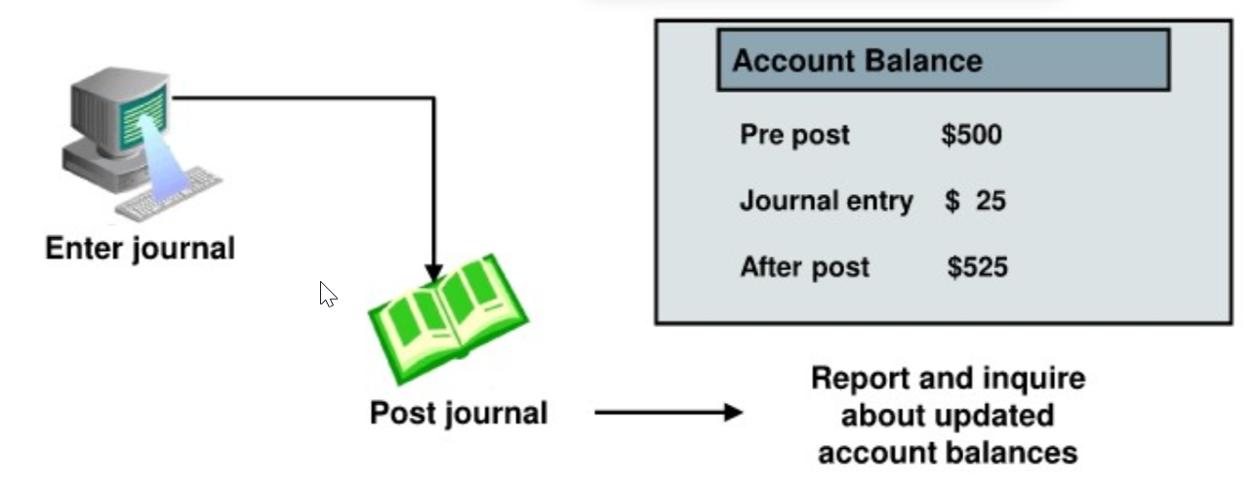
Posting and Automation
Posting: Key Concepts
Journal posting is a process that updates balances in general ledger accounts
to reflect an entity's business transactions and provides data for financial reporting.
Functionality:
Once a journal batch is posted, its contents cannot be modified
Posted journals cannot be deleted but can be copied or reversed
Timing:
Journal entries can be posted to a current or prior accounting period, or to an open prior fiscal year.
If you post a journal entry into a prior year, the retained earnings balance is adjusted for the effect on the income and expense accounts.
Automatic Posting using AutoPost Criteria Sets:
These posting criteria sets use Ledger, period, source, and category to select the journal entries for posting
Important for journal imports from subledgers because it prevents editing of the journal import data.
Can be scheduled to run on a periodic basis for various ledgers
Understanding Journal Posting Statuses :
Incomplete
Selected for Posting
Processing
Error
Posted
Batch has been saved but not completed
Cannot be posted`
Batch was selected but that the posting process has not begun.
Batch was selected but that the posting process has not begun.
Posting failed because of errors
Journal Batch is successfully posted

Slide 40
Conversion – Data Elements
Following table represents scope for master/transactional data conversions
No | Action Item | Comment | Extraction Criteria (recommended)
1 | Fixed Asset Conversion
2 | General Ledger YTD Journals Conversion
3 | General Ledger Balances Conversion
4
5
6
7

Slide 41
Key Integrations
Following table represents scope for integrations with edge applications as per current landscape
No | Integration | Source System | Target System
1
2
3
4
5
6
7
8

Slide 42
Appendix

Slide 43
Oracle Cloud Snippets for General Ledger

Slide 44
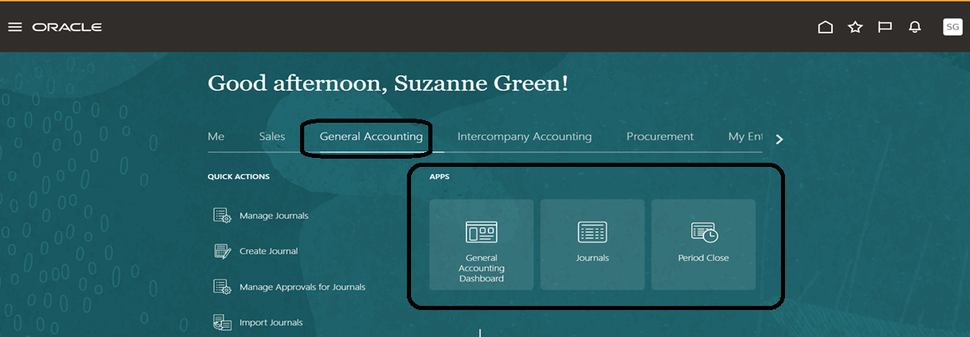
Landing Page of Oracle Cloud Instance Demonstration Purpose Only
General Accounting Tab and its Functions to access the desired view

Slide 45
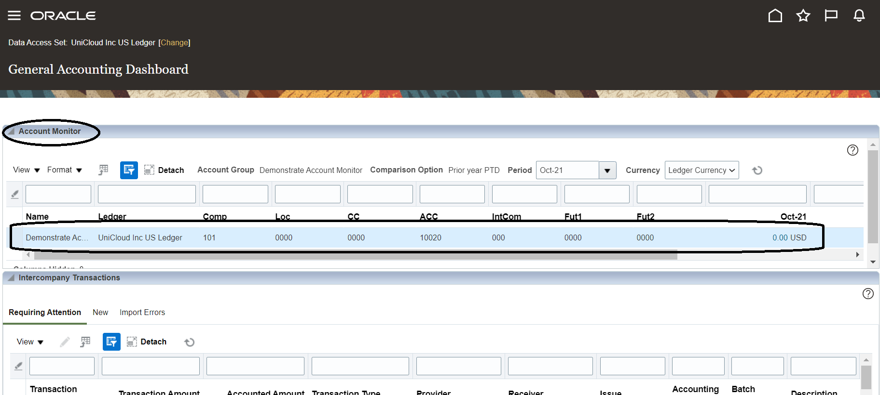
Accessing the General Accounting Dashboard
General Accounting Dashboard and its components
Comparison with last period/year or budgets
Drill to detail balances and subledger transaction details.

Slide 46
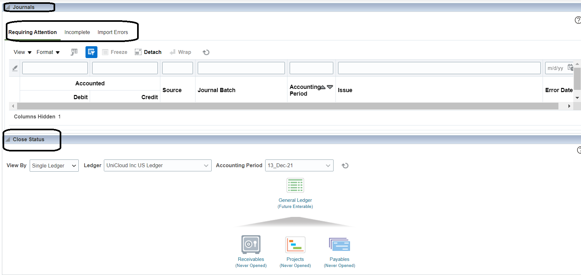
Journals and Close Status Tabs from General Accounting Dashboard

Slide 47
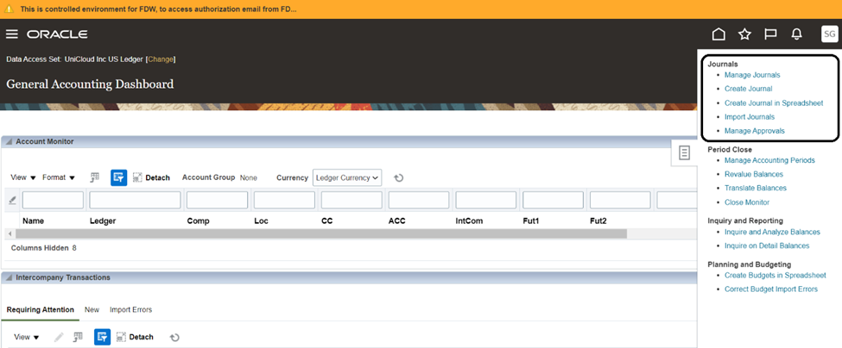
Accessing the Task Pane with list of Options can be utilized for Transactions and Reporting Purposes:

Slide 48
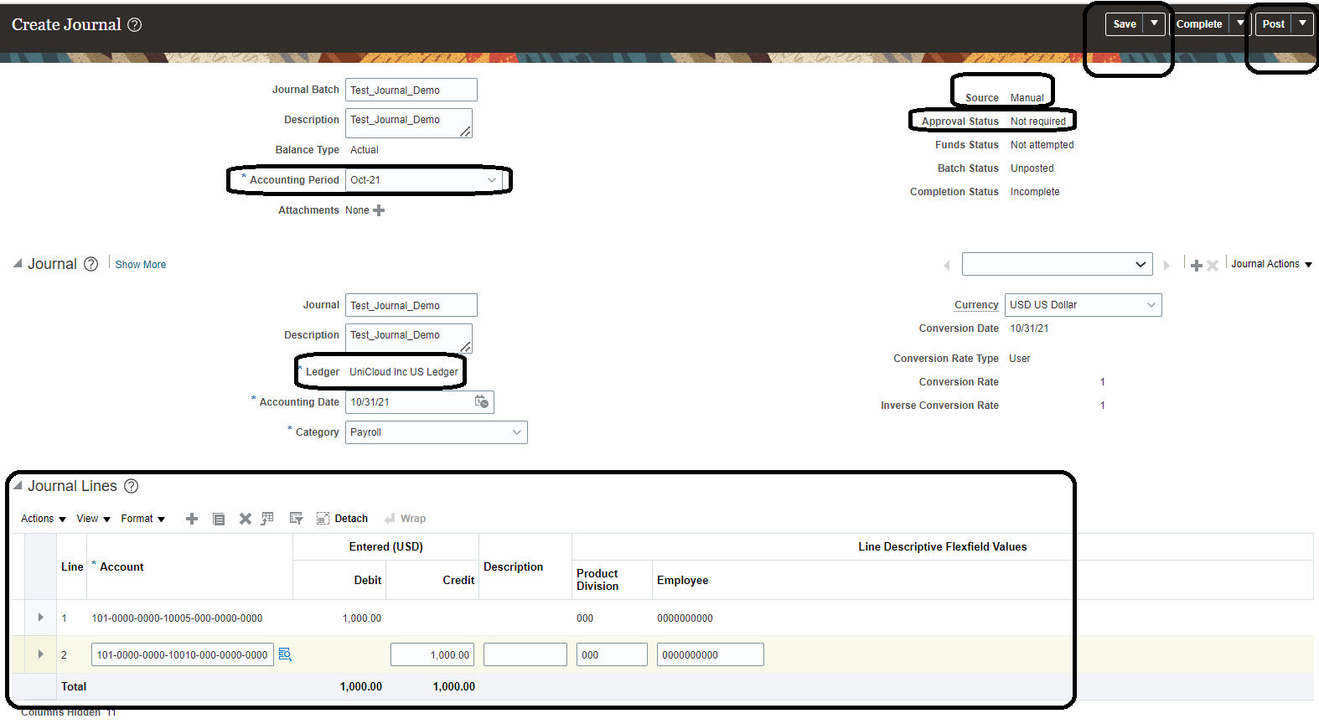
Creation of a Manual Journal of Payroll in Oracle User Interface

Slide 49
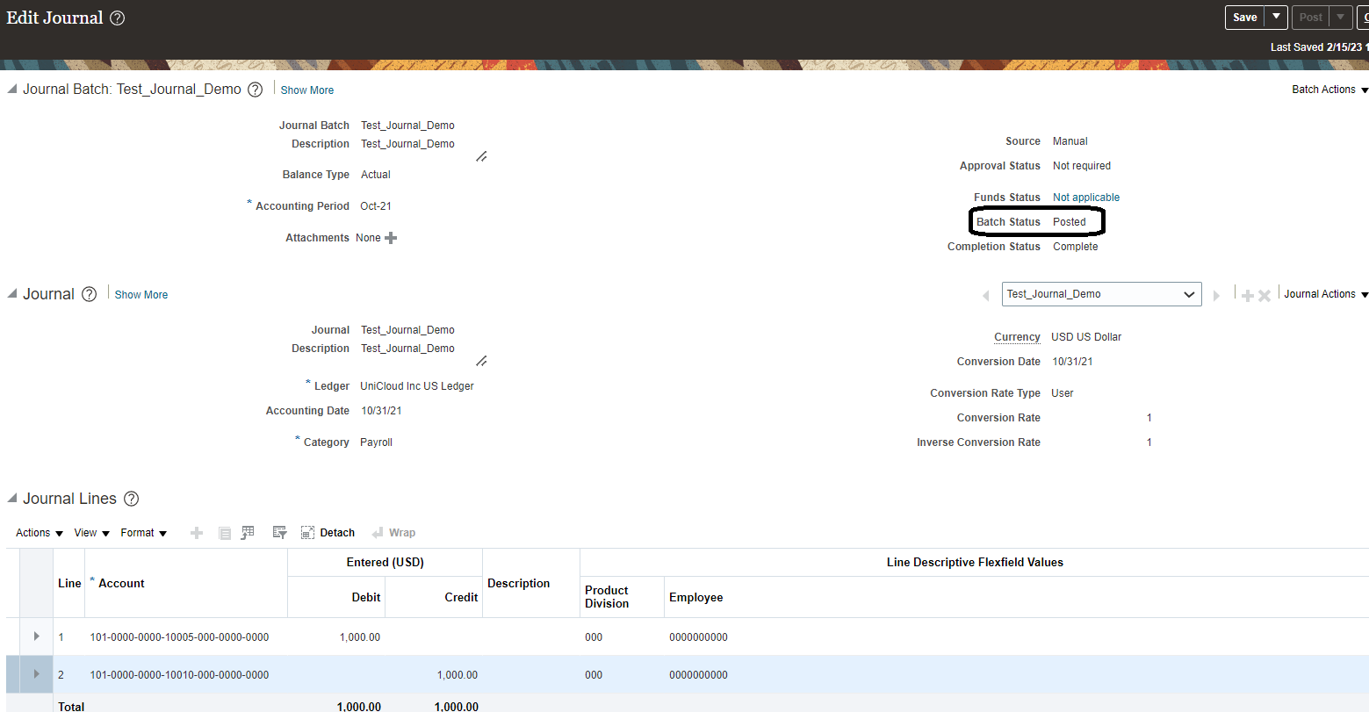
Posting Status of Manual Journal in Oracle User Interface

Slide 50
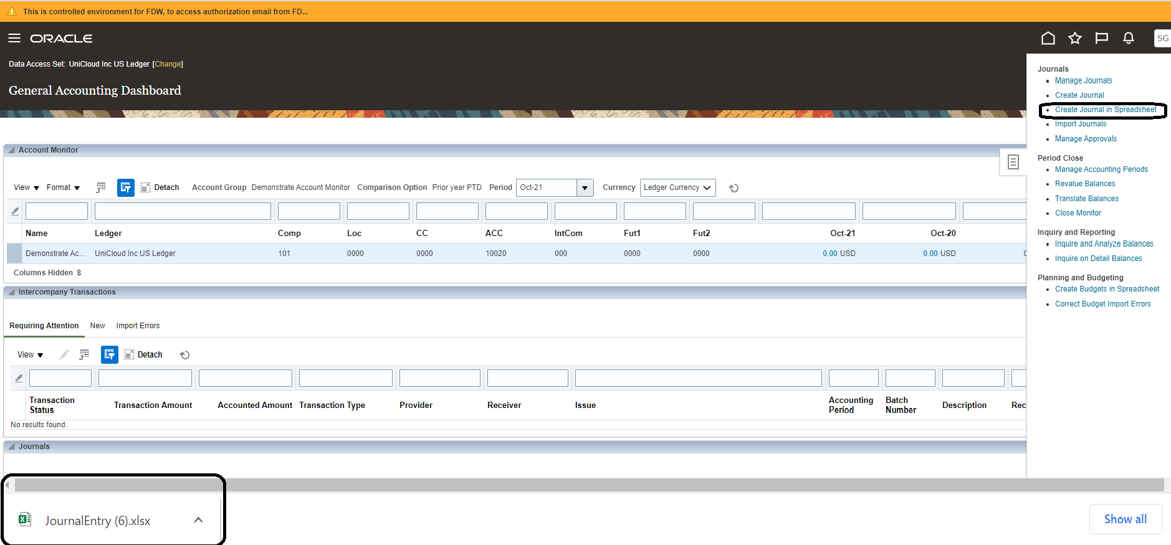
Creation of a Spreadsheet Journal Using - ADFDi

Slide 51
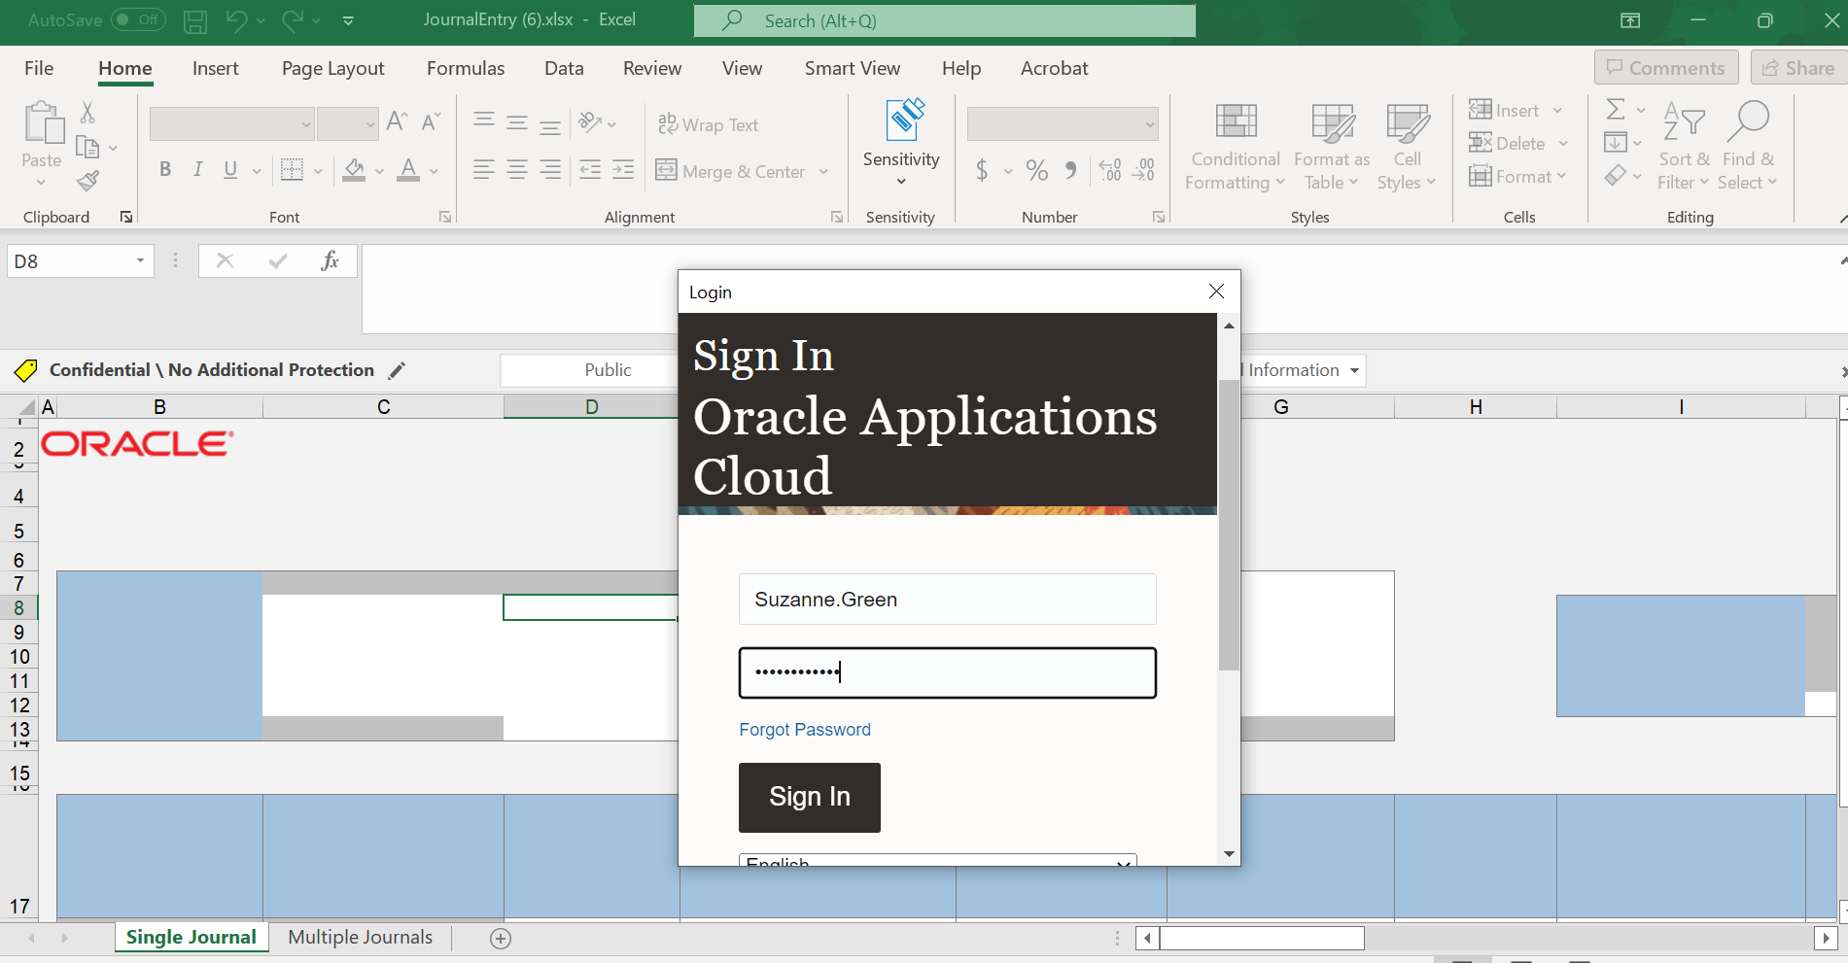
Creation of a Manual Journal of Payroll Using Spreadsheet (ADFDi)

Slide 52
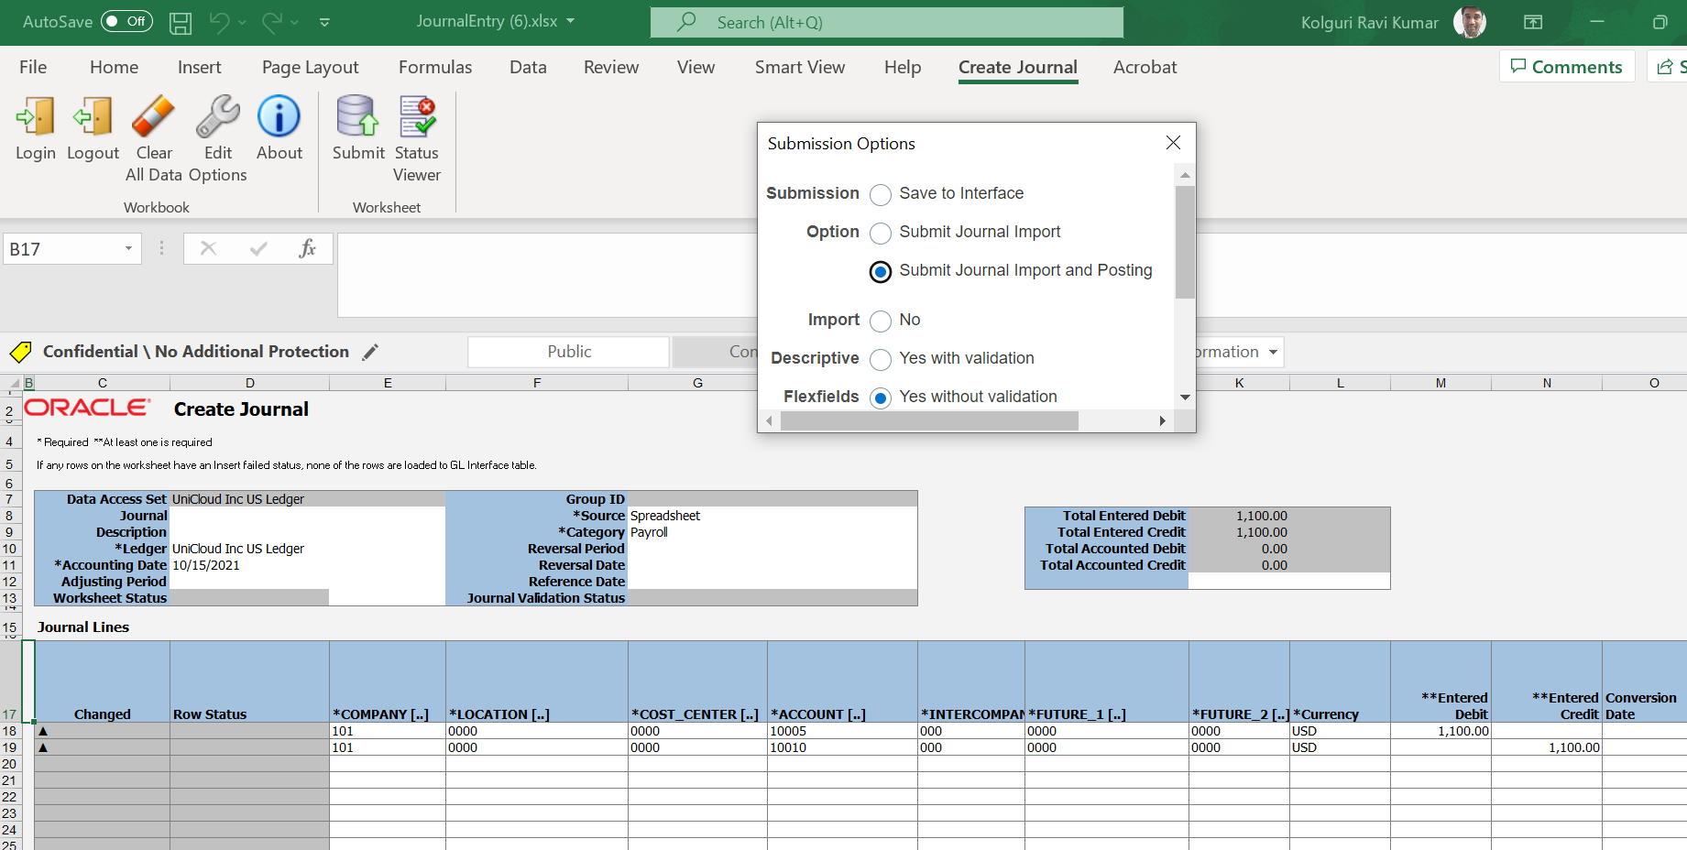
Creation of a Spreadsheet Journal of Payroll Using (ADFDi)

Slide 53
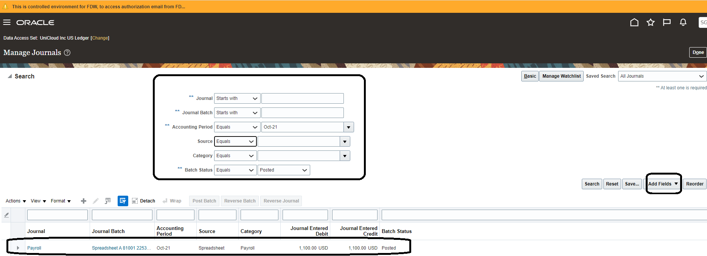
Manage Journals Section
Querying the Spreadsheet Journal what we created in our previous slide

Slide 54
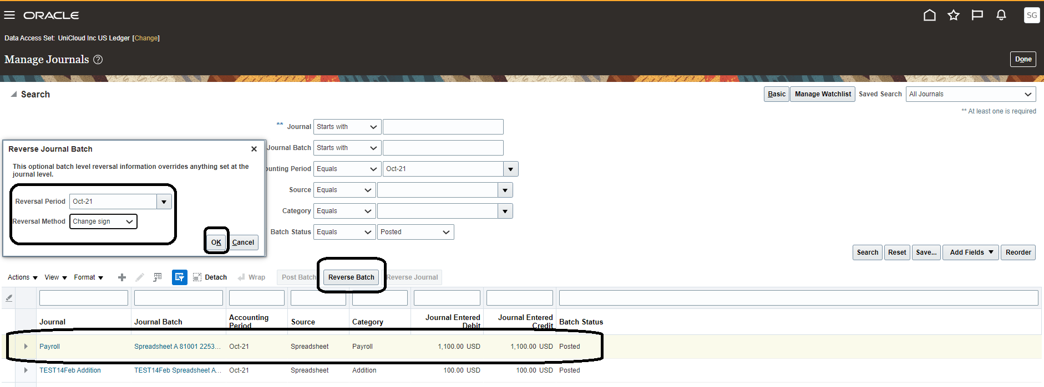
Manage Journals Section
Reversing the Batch which we created:

